Slide 1


Building the
HCP Journeys
April 2021

Slide 2
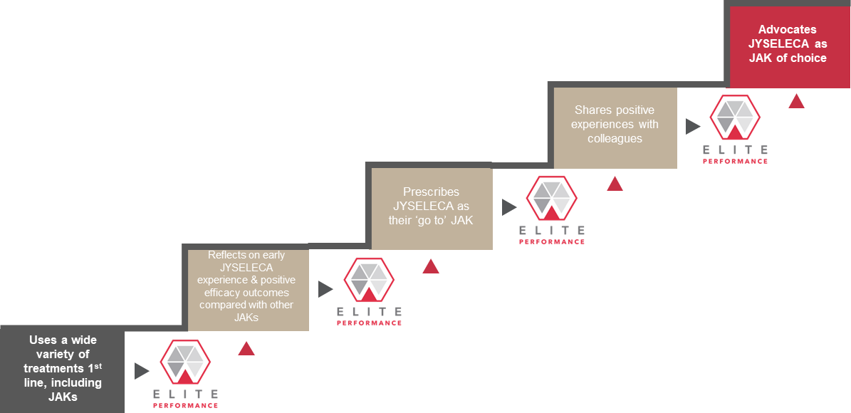
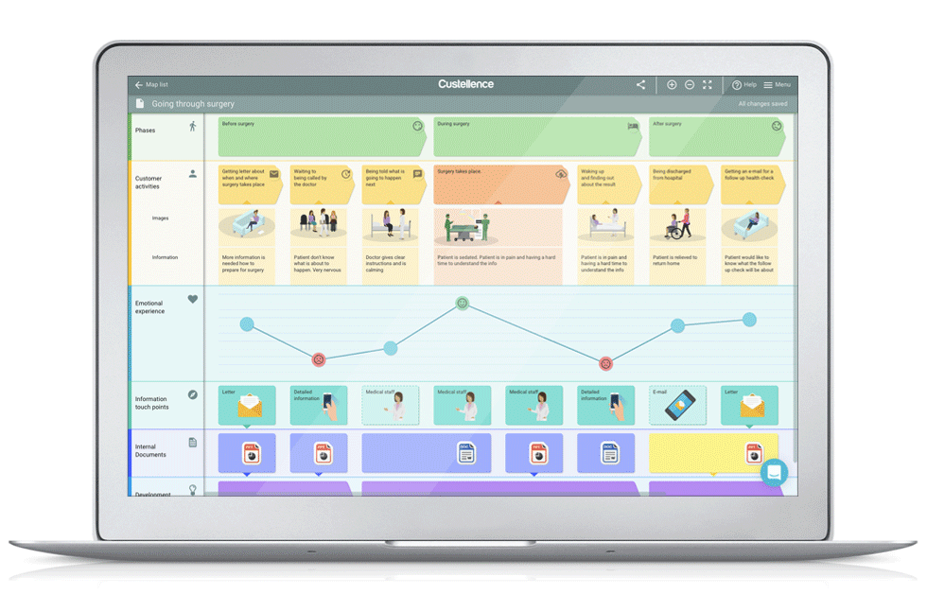
Adoption Ladder
HCP Journeys
The HCP-focused mapping of the level of product adoption.
The execution-focused mapping of the touchpoints with an HCP.

Slide 3
We are building the HCP Journeys based on a core set of Principles
Practical / Pragmatic
Linked to key events/milestones
Reflect brand plan and prioritization of activation
Linked to key conferences/events
Simple
Journeys are connected and not in isolation – Cross functional / co-ordinated approach
Addressing customer needs and preferences – leveraging market research (content, channel, style, time)
Actionable today = channel maturity, content is there, or where consent is required
Powered by Insight & data (try to combine where possible to see 360 view)
‘Aligned to CRM/CDP’
Various access points (into journey)
Leverages digital and physical touchpoints
Based on fact, not feeling (where possible)
Priority

Slide 4
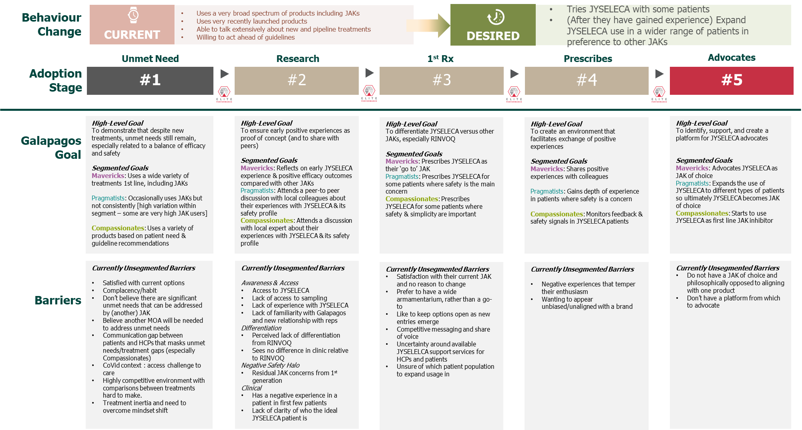
Each Journey map will be aligned to moving an HCP along one step in the Adoption Ladder
We will begin by using the ‘Marketing rule of 7’ → so defining 7 touchpoints required to move a HCP from adoption stage 1 to 2.
Once the journeys are being executed, we will be using analytics techniques to adapt the journeys to better represent the reality of how many touchpoints it takes (and what channels work better).
7 touchpoints

Slide 5
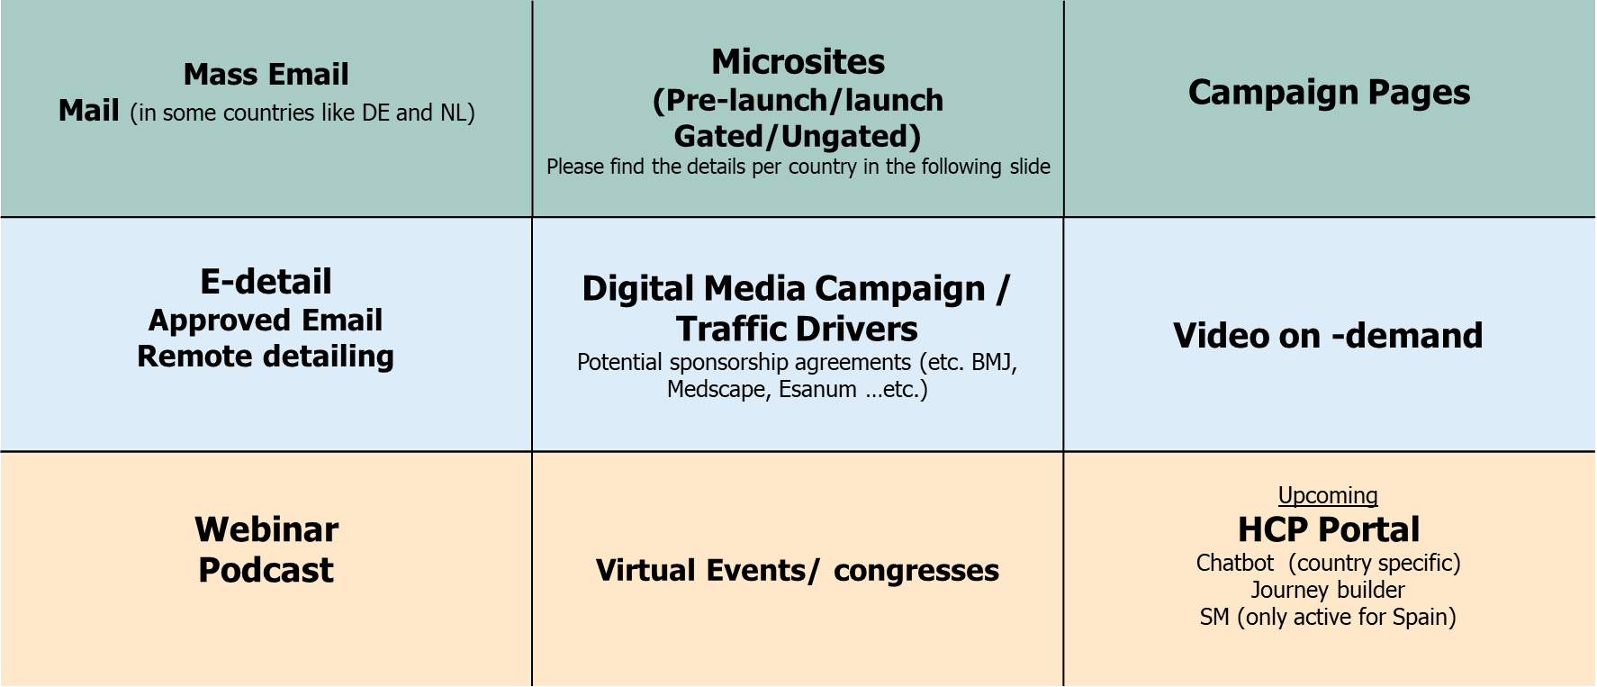
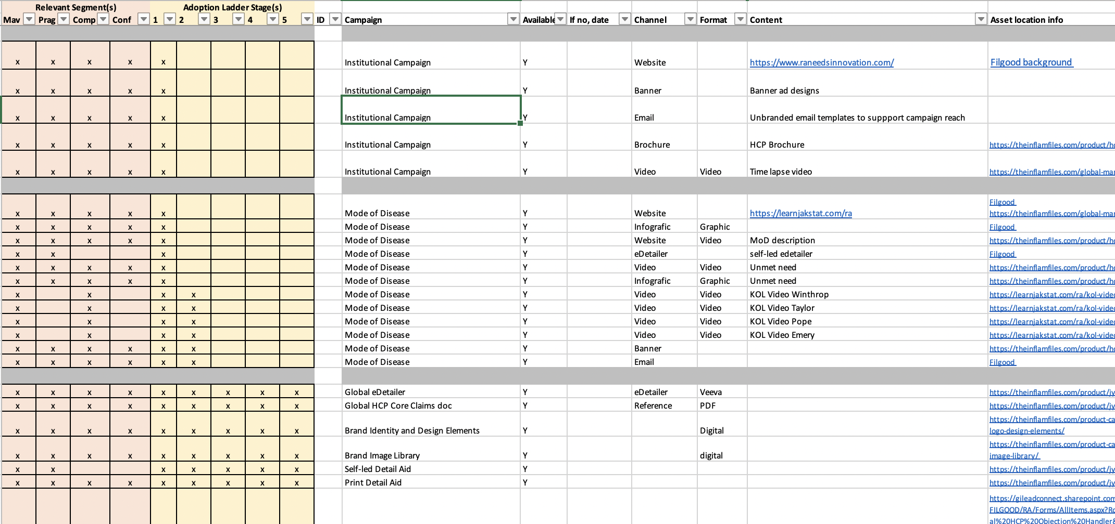
We will be leveraging the core Galapagos channels, and brand content.
Core Channels
Existing & Planned Content

Slide 6



We have explored a variety of tools to design the journeys
Easily Editable – Basic Changes
Easily Editable – Structural Changes
Learning Curve
Live Collaboration
Flexibility
Readability
Full map visualisation
Guided Journey Creation
Cost

Slide 7
Custellence
After comparing a multitude of tools, we believe Custellence has the best balance of features vs simplicity, with simplicity being key.
Custellence is a simple, 1-page journey creation tool, with collaboration functionality.
We are using Custellence solely to help guide the creation of HCP Journeys, not for use in the orchestration or execution of journeys.

Slide 8
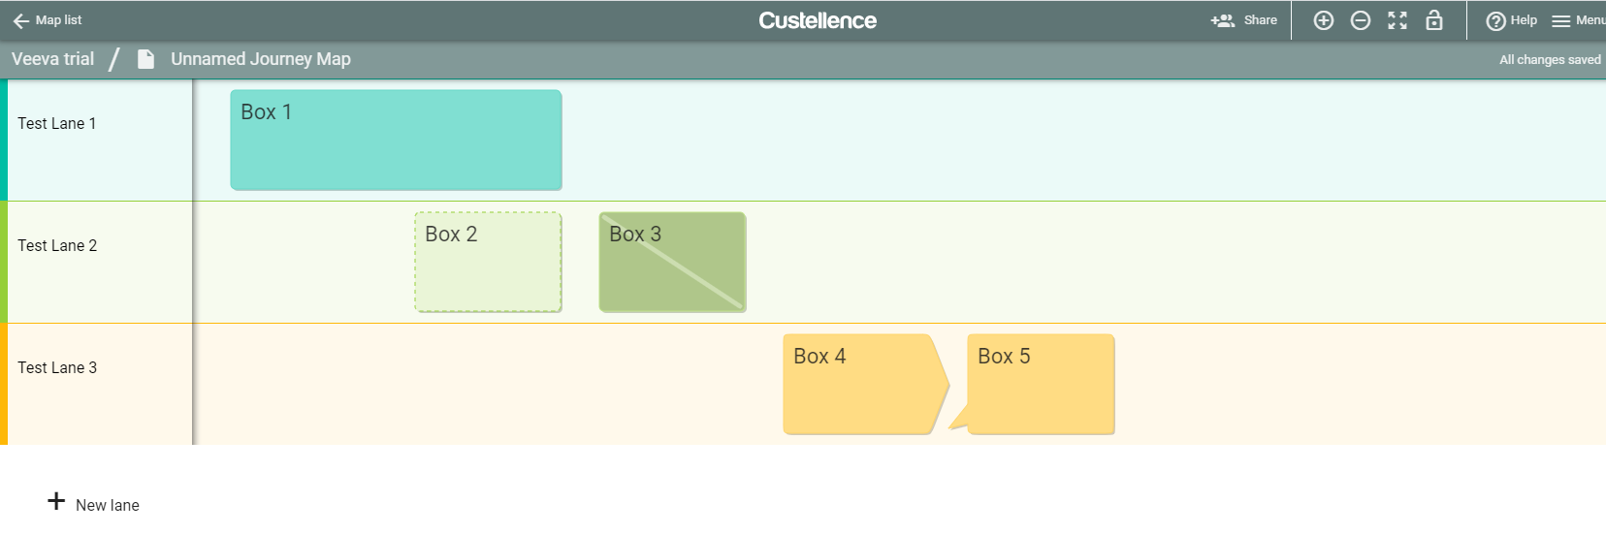
The tool is arranged in ‘lanes’, with boxes
Boxes can be different sizes
Boxes can be assigned different ‘statuses’
Different types of boxes can be added to the lanes

Slide 9
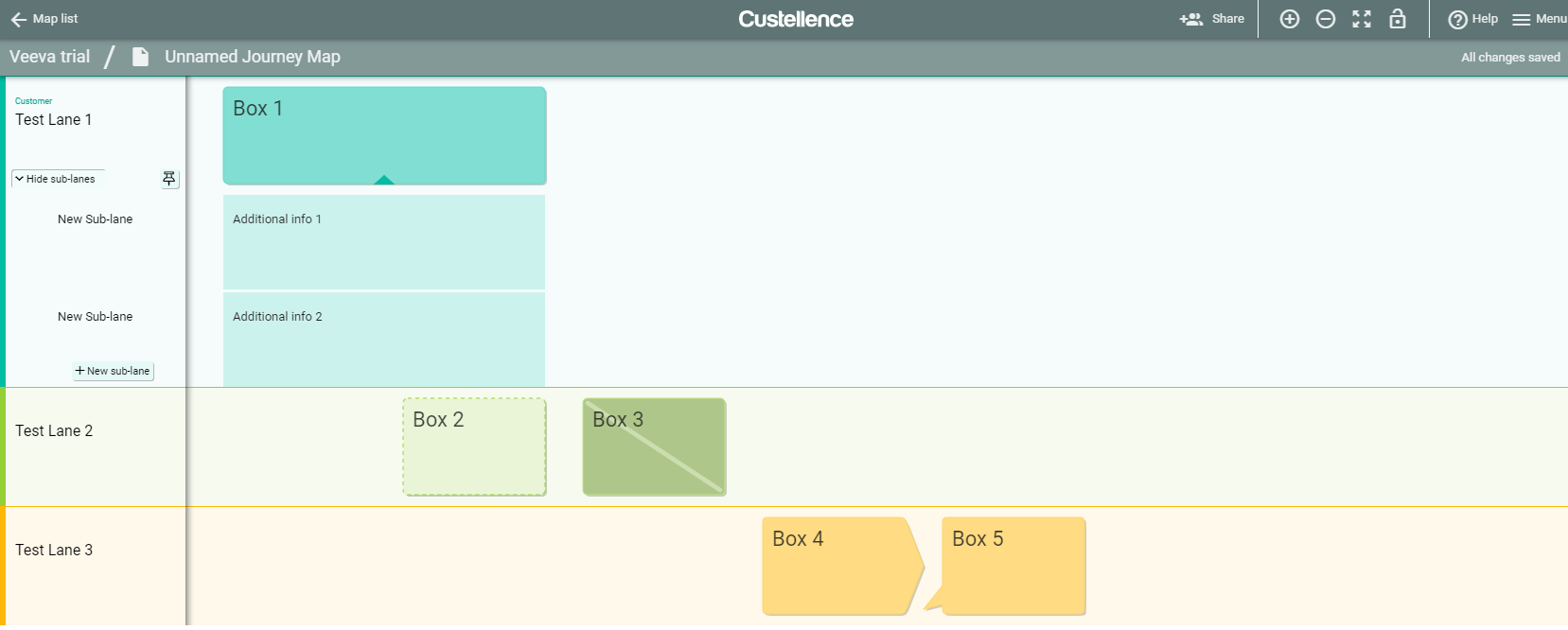
‘Sub-lanes’ can be hidden within a lane
Additional Lanes

Slide 10





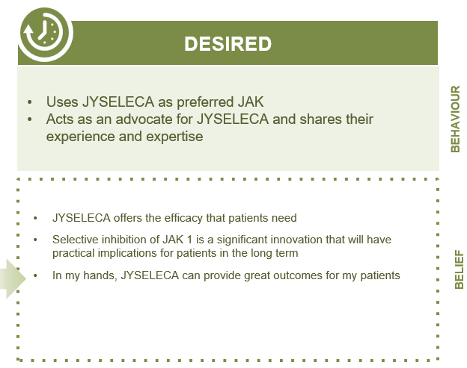
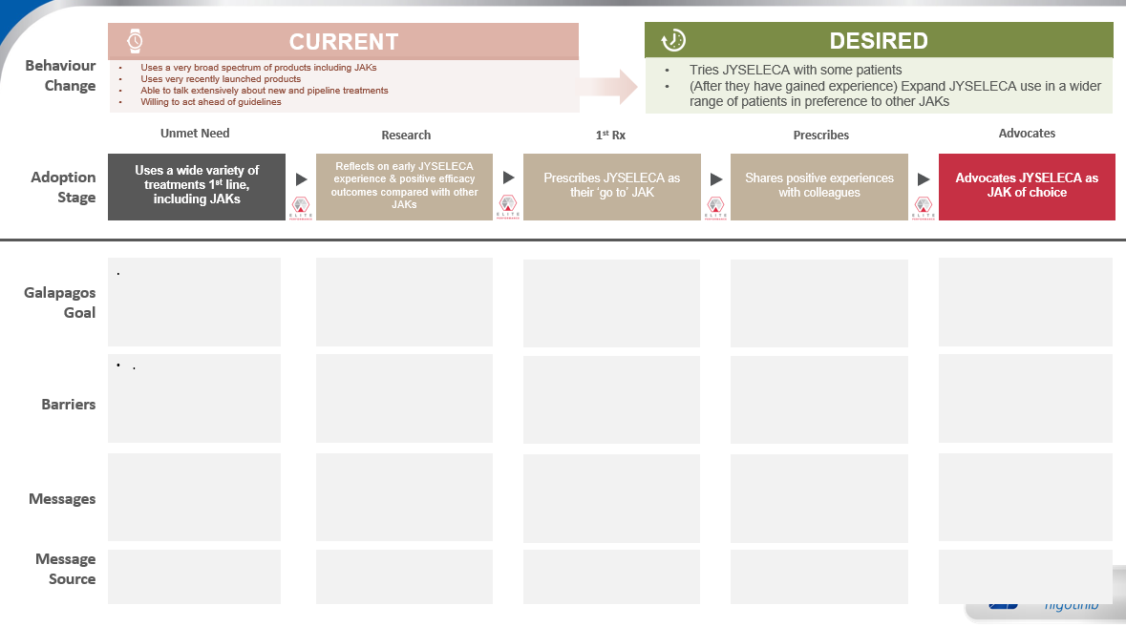

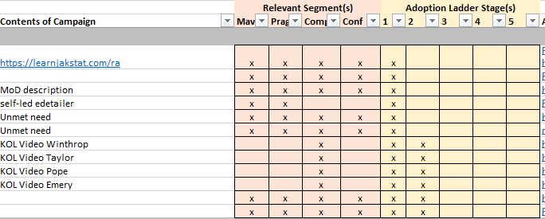
HCP Journey Components
In order to accelerate the creation of the journeys, in our experience it is valuable to first discuss the constituents of the Journeys.
Journey Scenarios
Segmentation
HCP Journeys
Behavioural Research
Key events
Adoption Ladder
Content & Channels
“Moments of Truth”

Slide 11


HCP Journey Scenarios
We can create HCP Journeys based on different categories or Scenarios, for example:
Rep-Driven
HCP-Driven
Event-Driven

Slide 12
The HCP Journey Design

Slide 13
Journeys Overview
What the HCP Journeys are
Representations of ways to drive a flow of continued engagement, leveraging the core channels and content
Guidance for connecting channels
Going to be localised to each market based on market channels, content, scenarios and preferences
What the HCP Journeys aren’t
The exact, granular touchpoints for all reps interactions with HCPs.

Slide 14
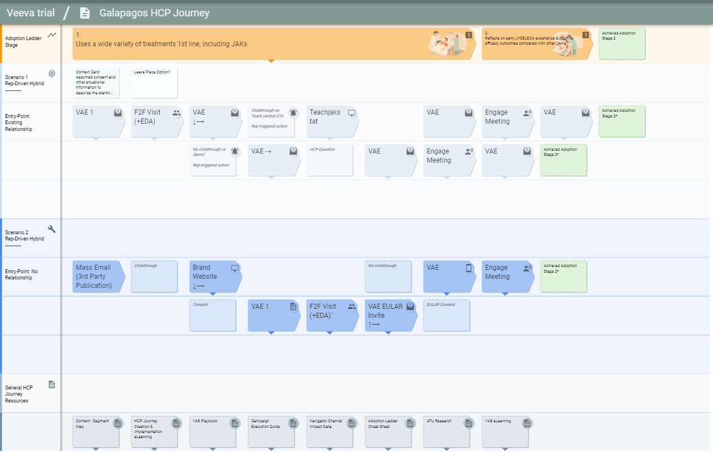
The Journey Map Template
Details

Slide 15
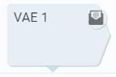
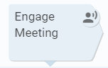
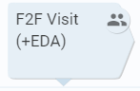
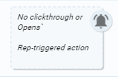
We have defined different box types
Channel boxes are arrow-shaped and the type demonstrated by the box icon/
Other boxes are square and more ‘transparent’, which outlines a connecting action, such as an email click-through or no clickthrough

Slide 16
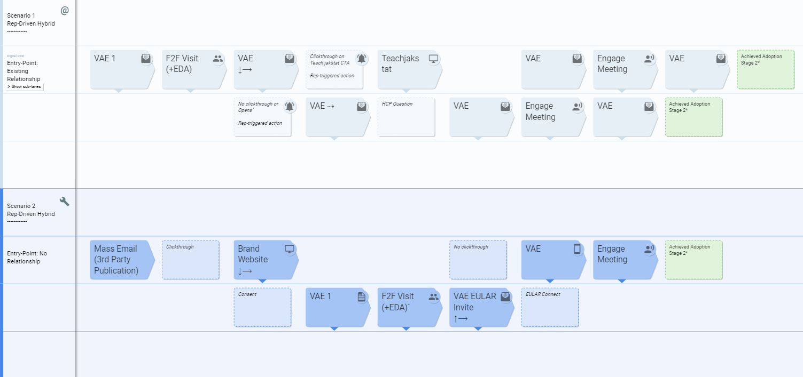
The different scenarios will be colour coded by their lanes

Slide 17
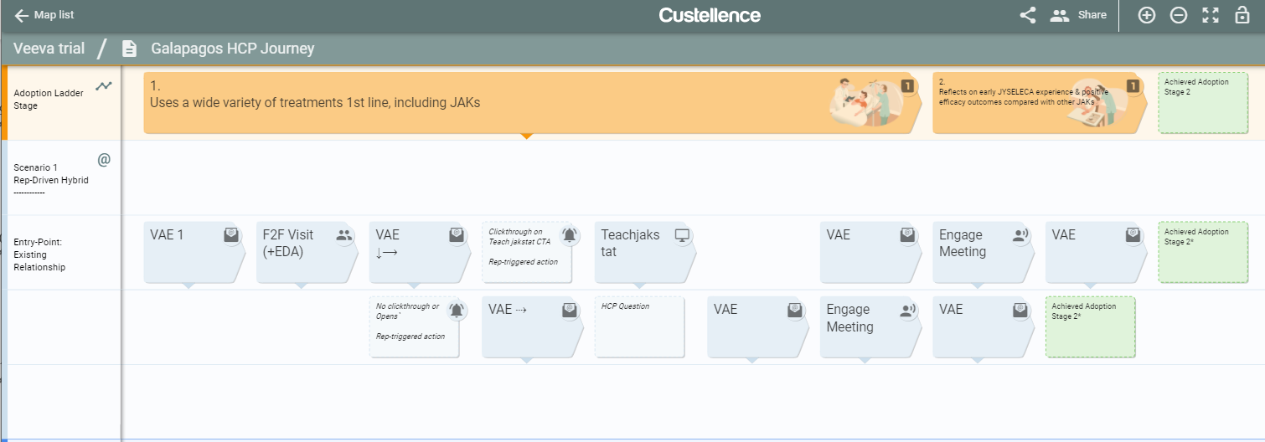
The Adoption stage is highlighted in the top row

Slide 18
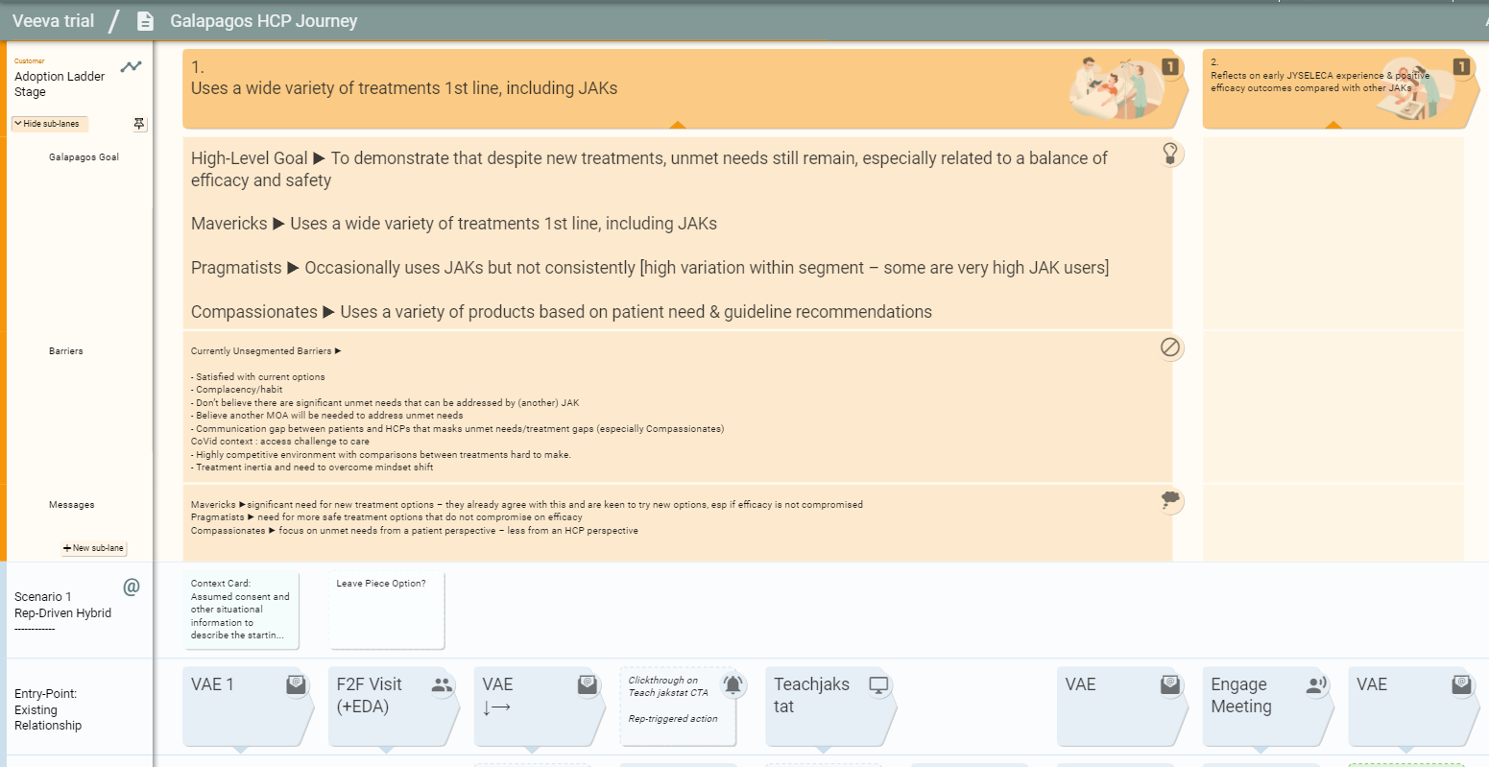
Additional adoption stage detail is hidden in the sub-lanes
Sub-lanes

Slide 19
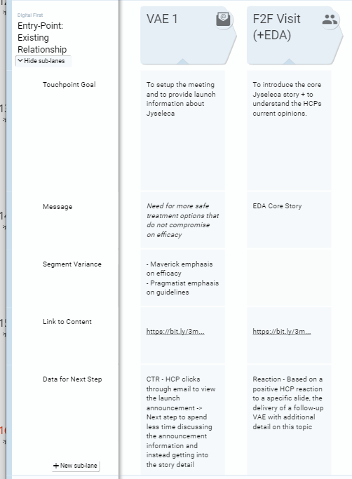
Details about each touchpoint is also hidden in sub-lanes

Slide 20
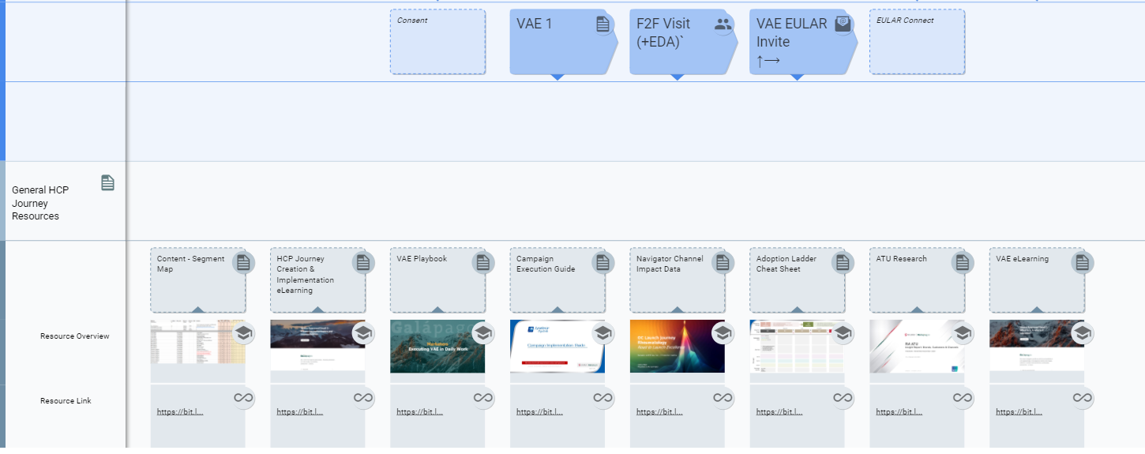
Relevant Resources are linked at the bottom of the map

Slide 21
View the Template
https://custellence.com/app/public/43208111

